Slide 1
Financial statement analysis
Of
Dhaka Electric Supply Company Ltd. (DESCO)
&
TITAS Gas Transmission and Distribution Company Ltd.

Slide 2

VERTICAL ANALYSIS

Slide 3
Vertical Analysis (Balance Sheet)
TITAS
Particulars | June 30, 2021 |  | June 30, 2020
 | Amount in Taka | Percentage | Amount in Taka | Percentage
ASSETS
Non-current Assets | 53,195,628,122.00 | 29.47% | 58,738,552,101.00 | 32.52%
Current Assets | 127,327,858,394.00 | 70.53% | 121,857,457,009.00 | 67.48%
Total Assets | 180,523,486,516.00 | 100.00% | 180,596,009,109.00 | 100.00%
EQUITY AND LIABILITIES
Shareholders’ Equity | 71,783,221,940.00 | 39.76% | 70,621,664,474.00 | 39.10%
Non-Current Liabilities | 29,563,592,263.00 | 16.38% | 27,105,613,285.00 | 15.01%
Current Liabilities | 79,176,672,313.00 | 43.86% | 82,868,731,349.00 | 45.89%
Total Equity and Liabilities | 180,523,486,516.00 | 100.00% | 180,596,009,109.00 | 100.00%

Slide 4
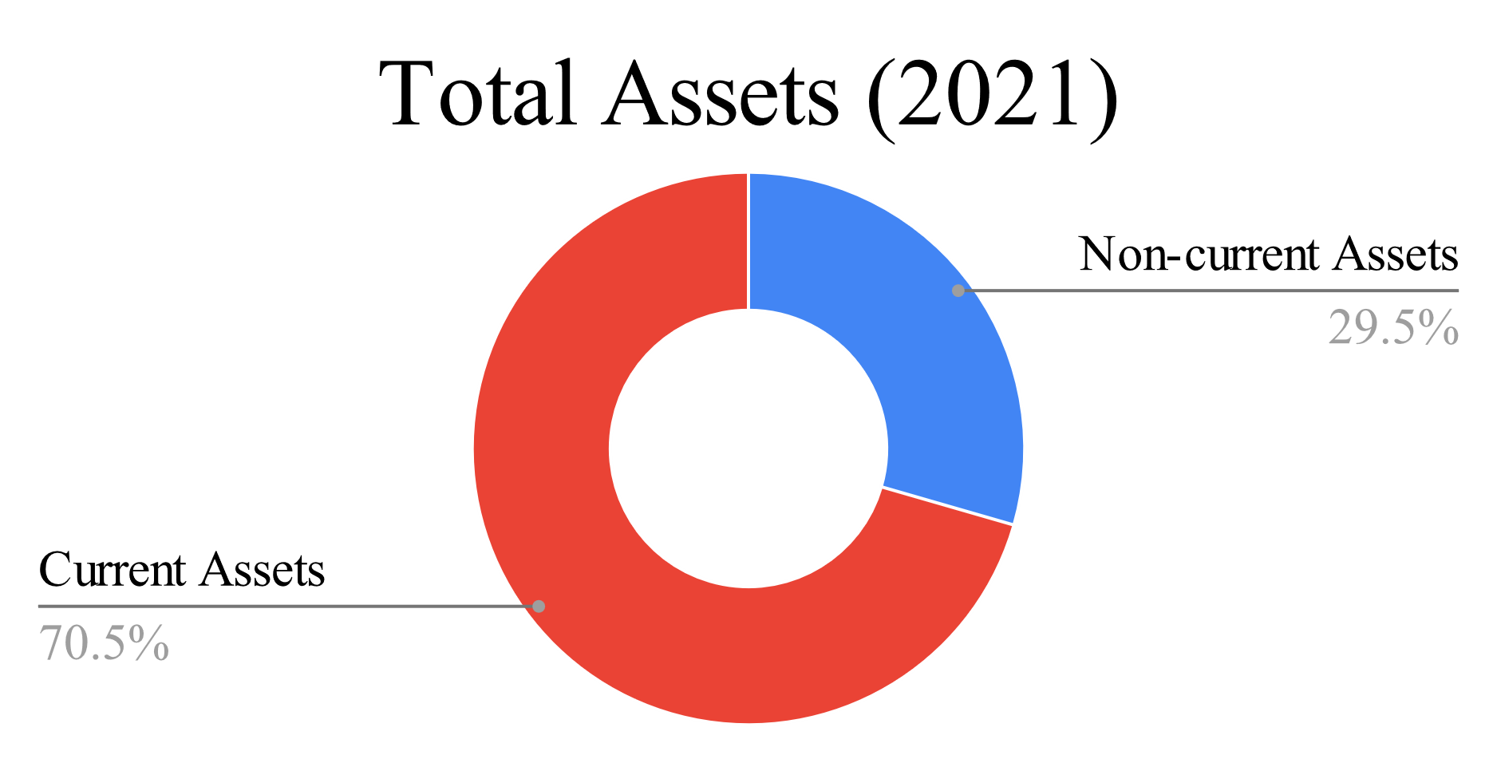
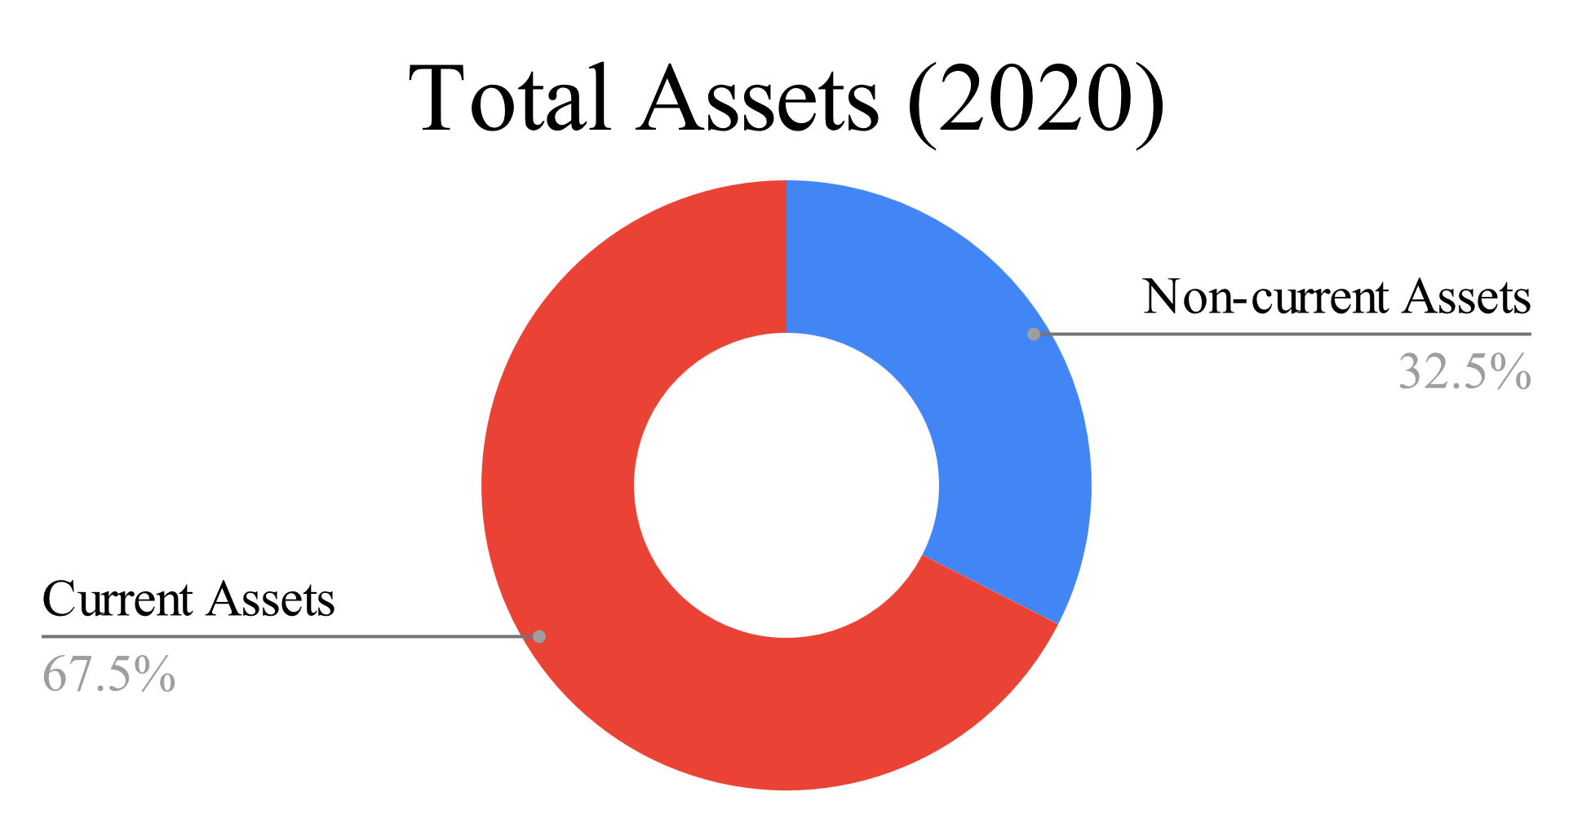
Vertical Analysis-TITAS (Balance Sheet)

Slide 5
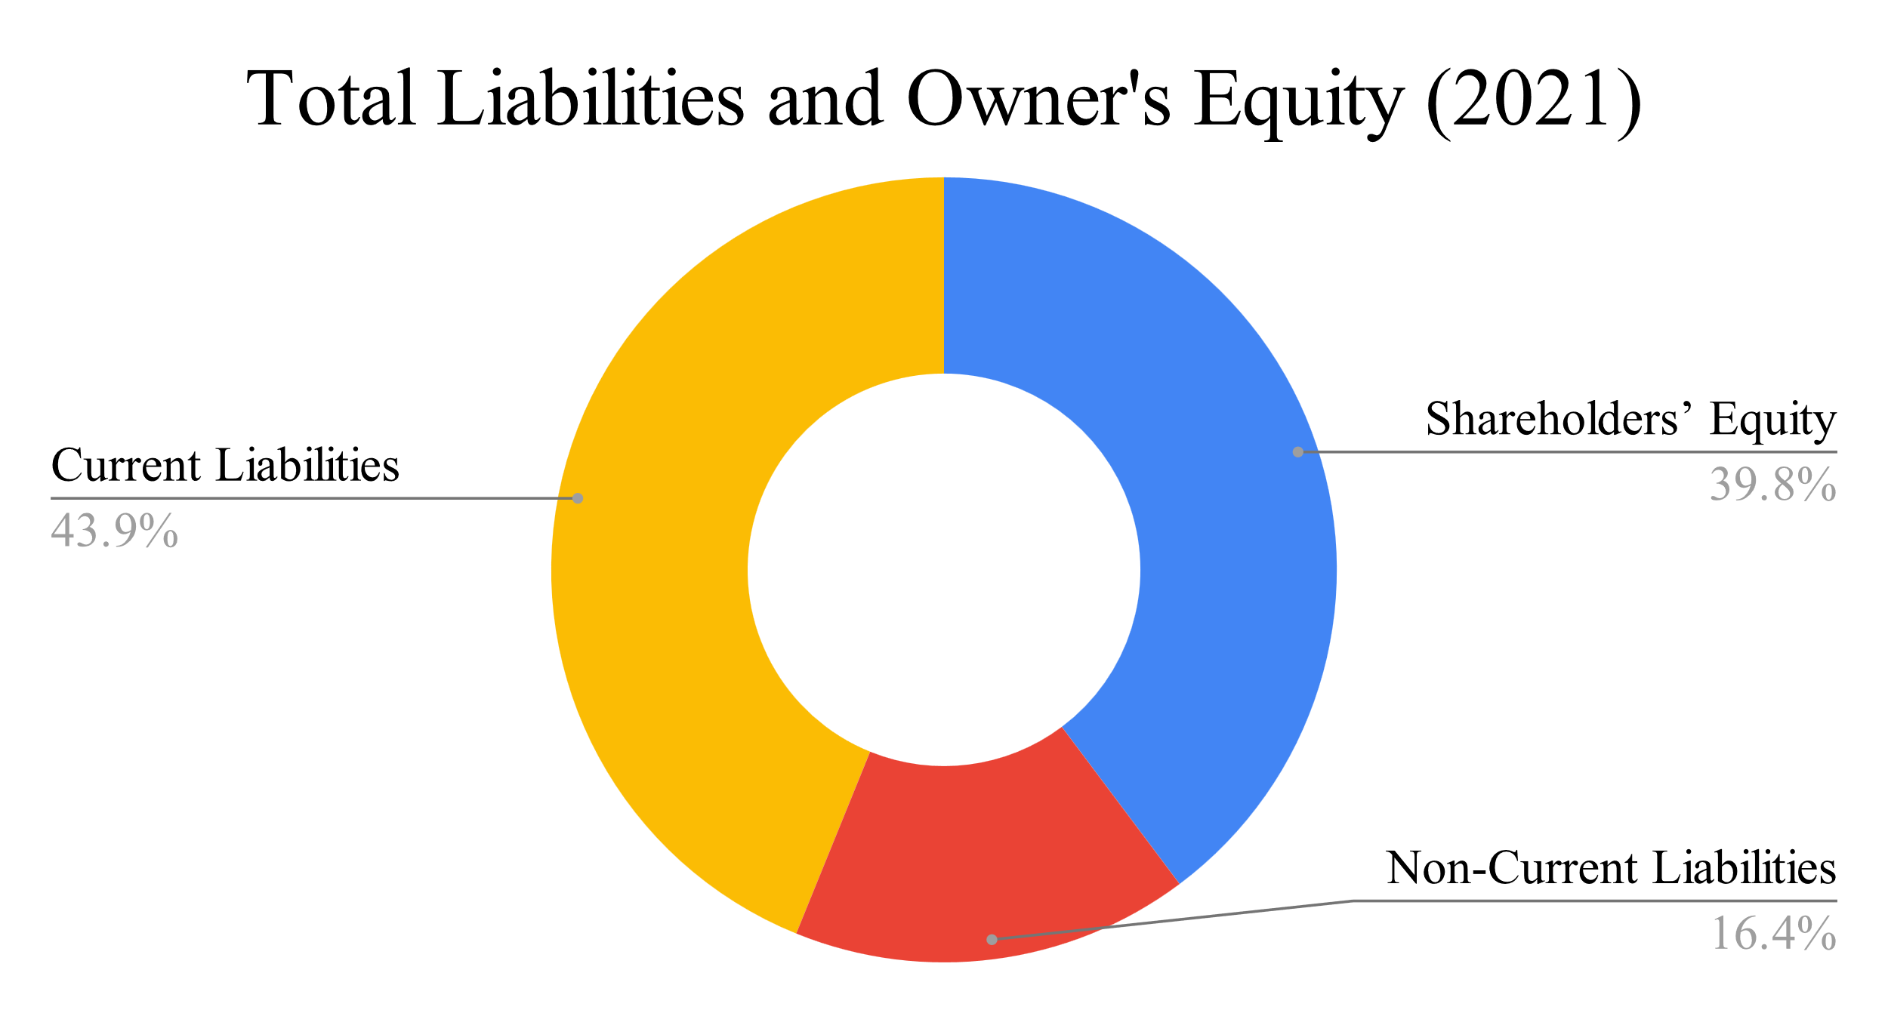
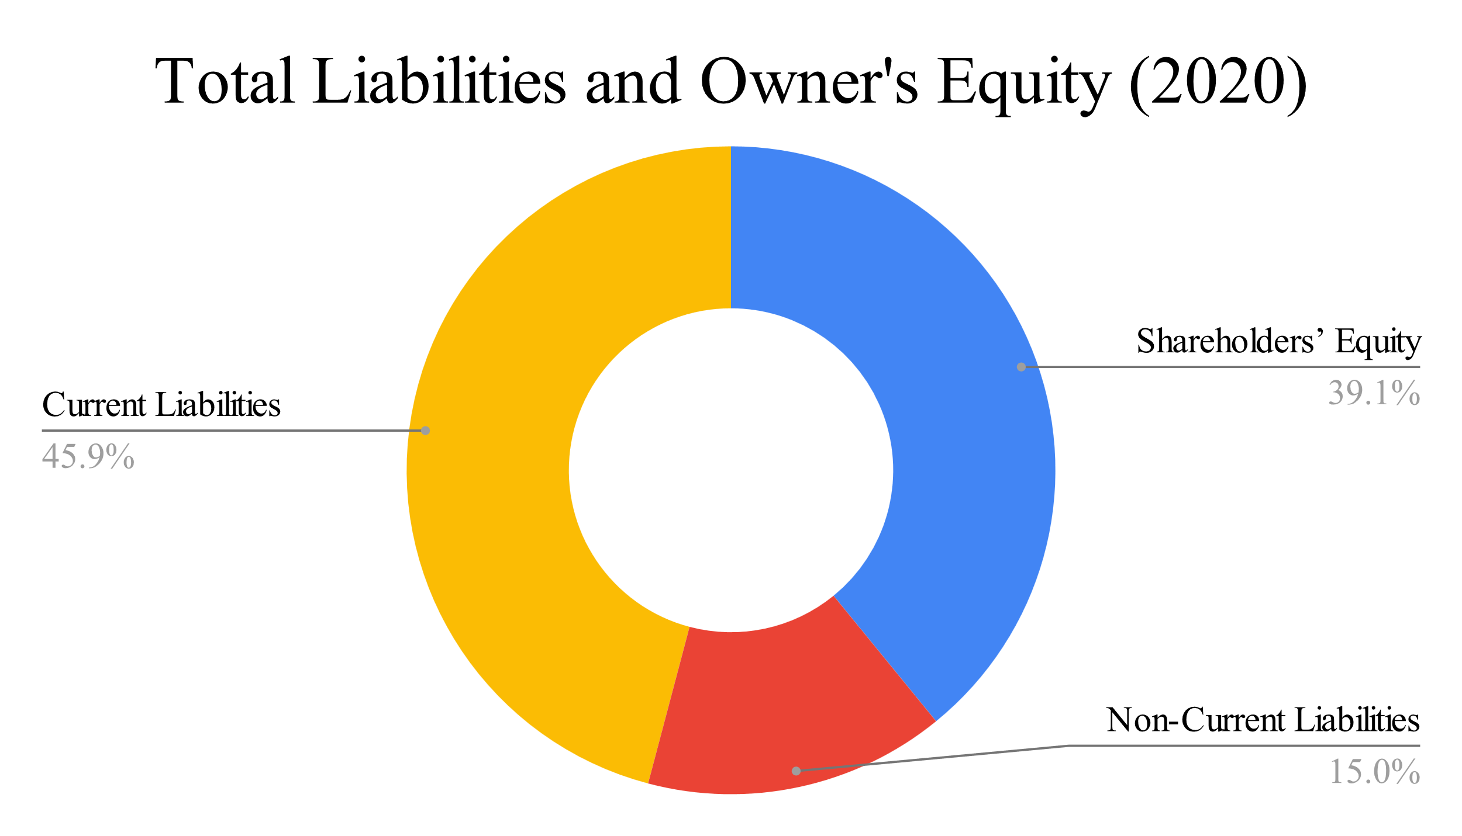
Vertical Analysis-TITAS (Balance Sheet)

Slide 6
Vertical Analysis (Balance Sheet)
DESCO
Particulars | June 30, 2021 |  | June 30, 2020
 | Amount in Taka | Percentage | Amount in Taka | Percentage
ASSETS
Non-current Assets | 52,202,477,849 | 65.96% | 40,585,729,350 | 57.40%
Current Assets | 26,940,114,942 | 34.04% | 30,117,446,368 | 42.60%
Total Assets | 79,142,592,791 | 100.00% | 70,703,175,717 | 100.00%
EQUITY AND LIABILITIES
Capital and Reserves | 25,938,786,858 | 32.77% | 18,589,300,583 | 26.29%
Long-term Liabilities | 35,182,962,340 | 44.46% | 33,913,532,799 | 47.97%
Current Liabilities | 18,020,843,592 | 22.77% | 18,200,342,334 | 25.74%
Total Equity and Liabilities | 79,142,592,791 | 100.00% | 70,703,175,717 | 100.00%

Slide 7
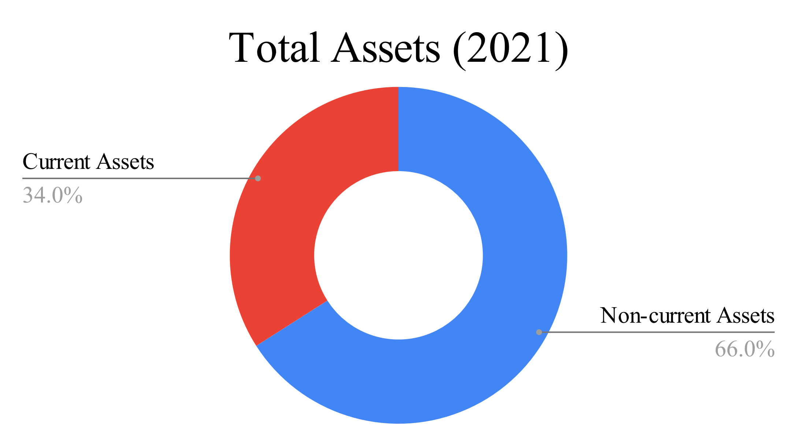
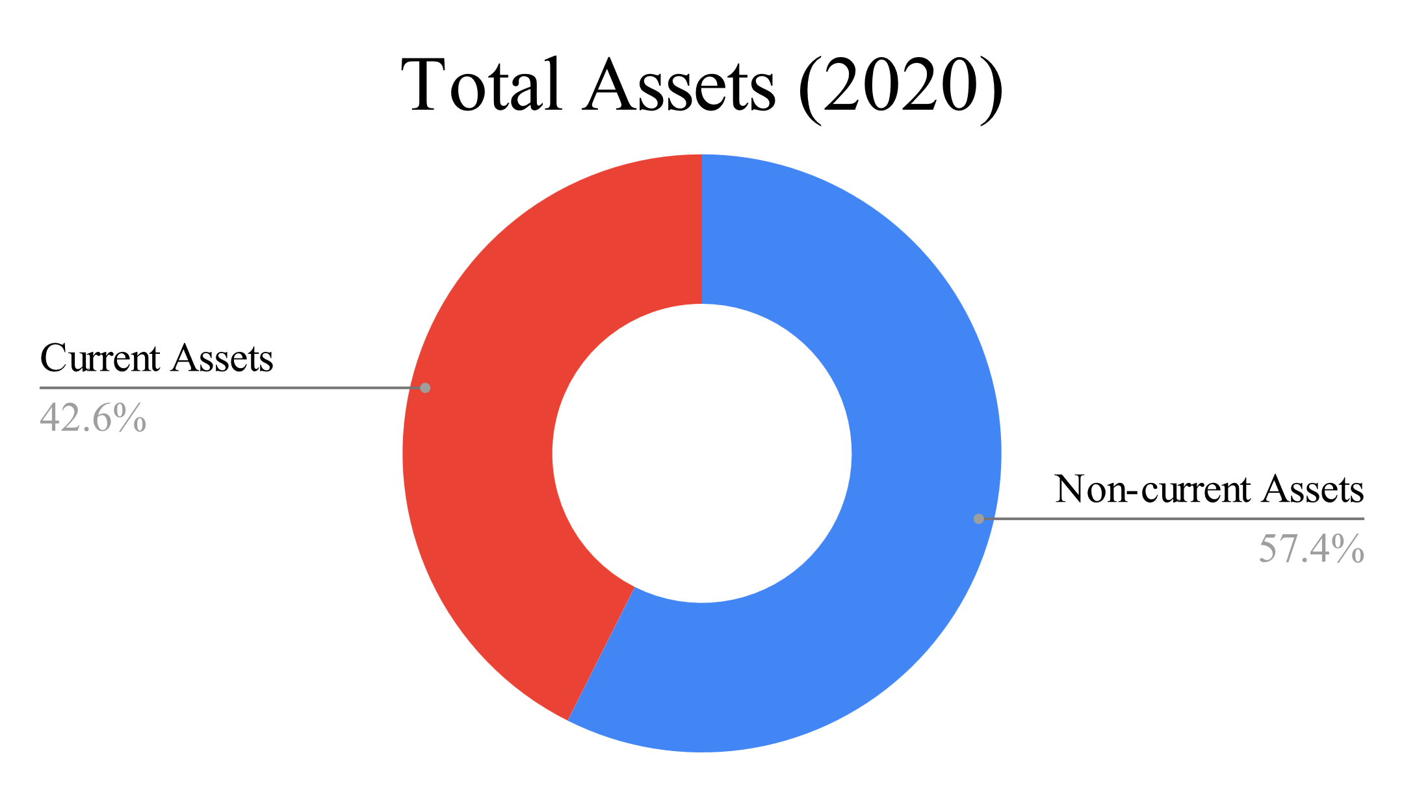
Vertical Analysis-DESCO (Balance Sheet)

Slide 8
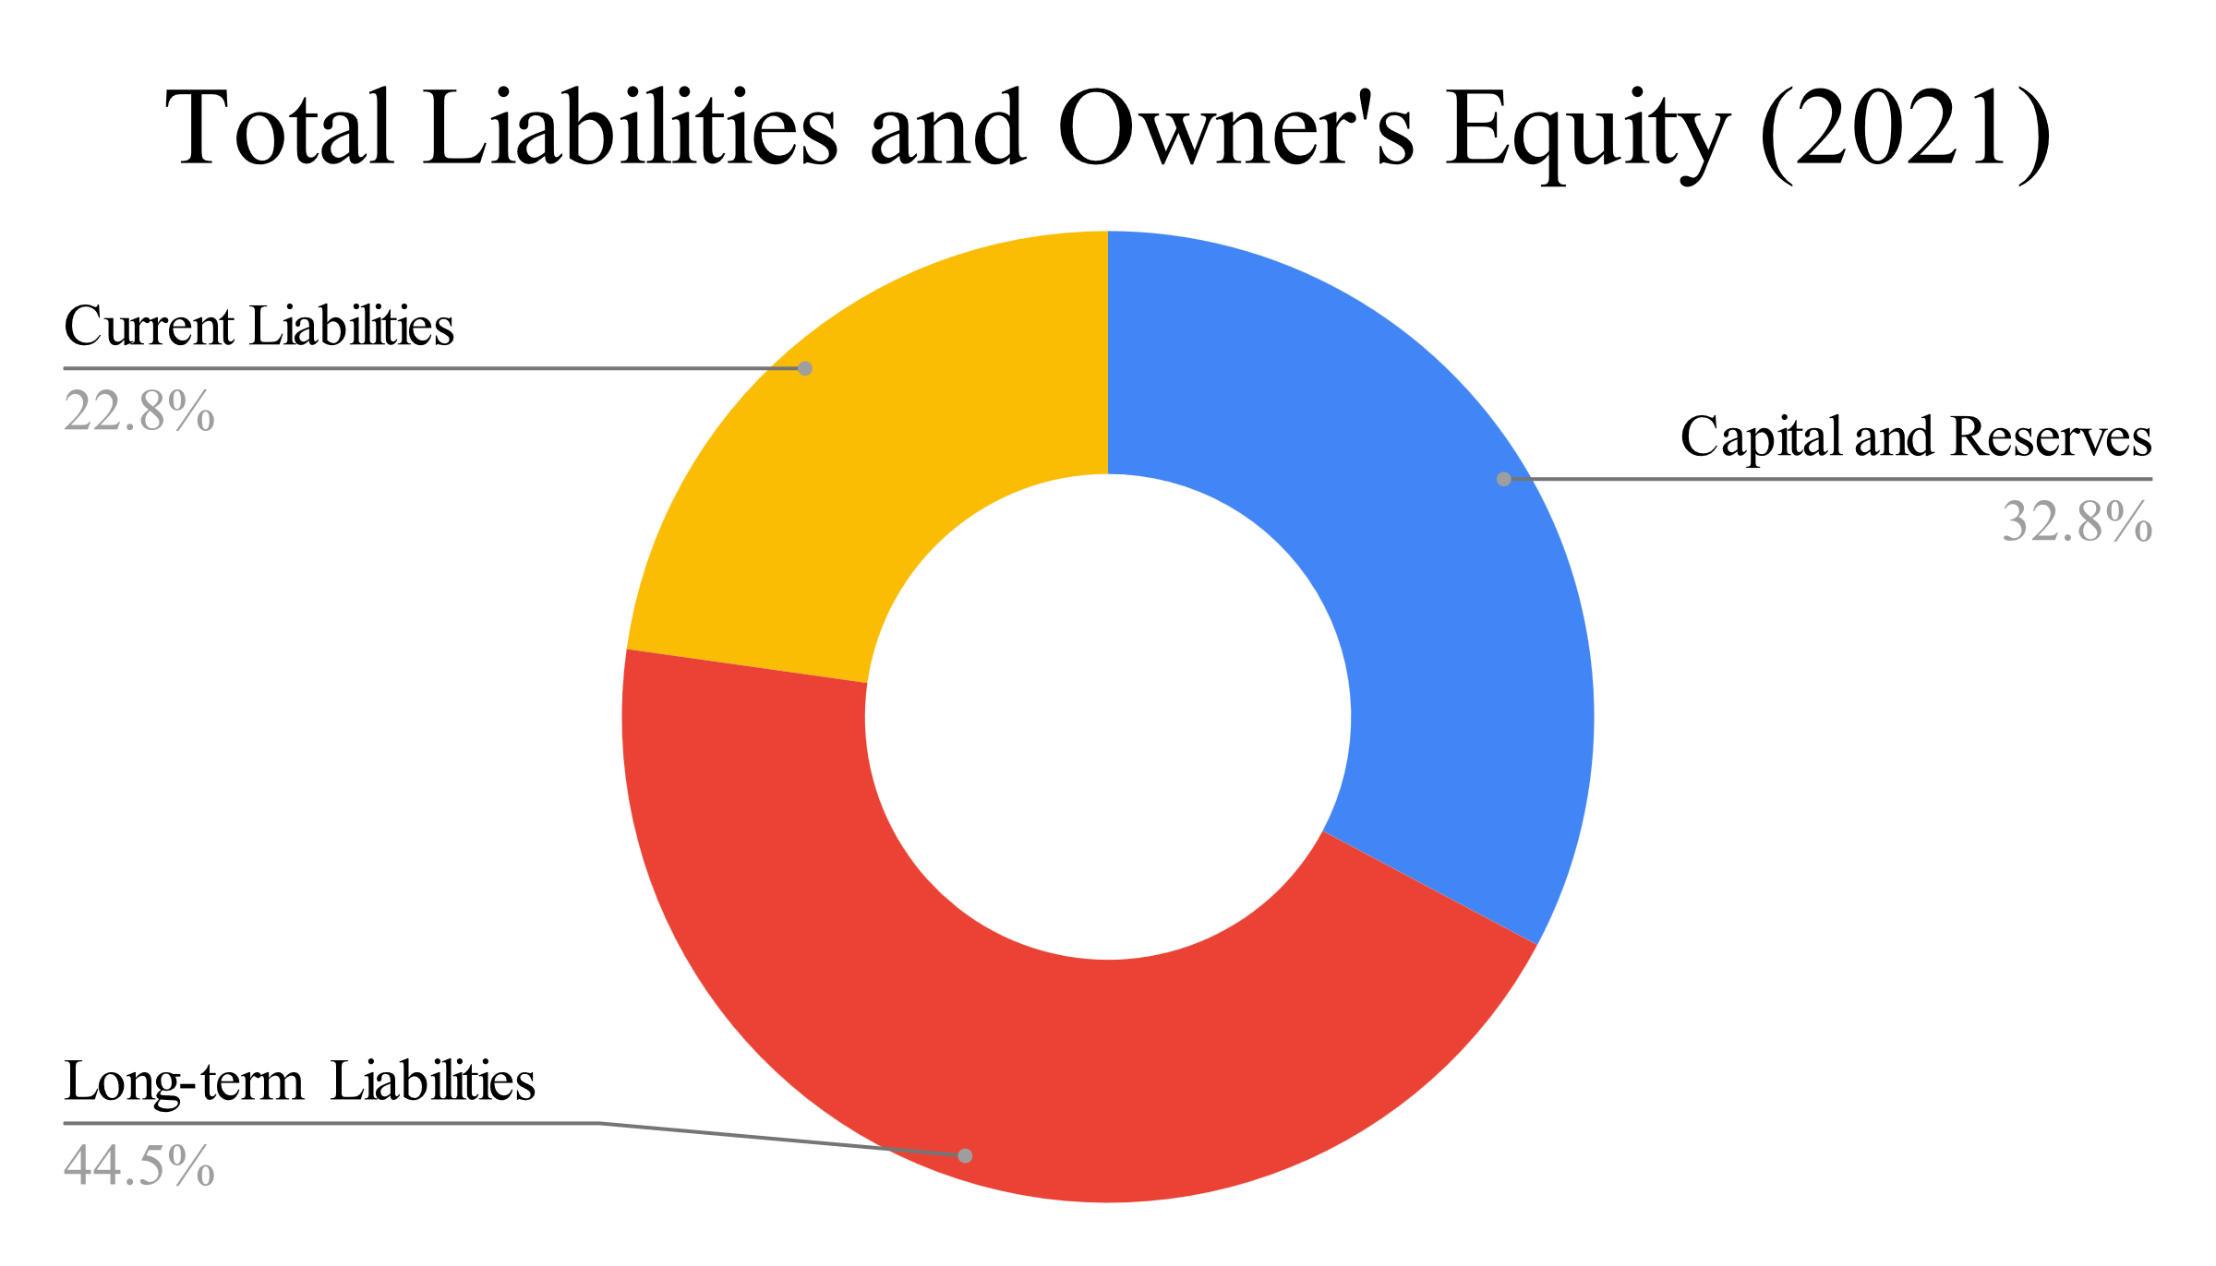
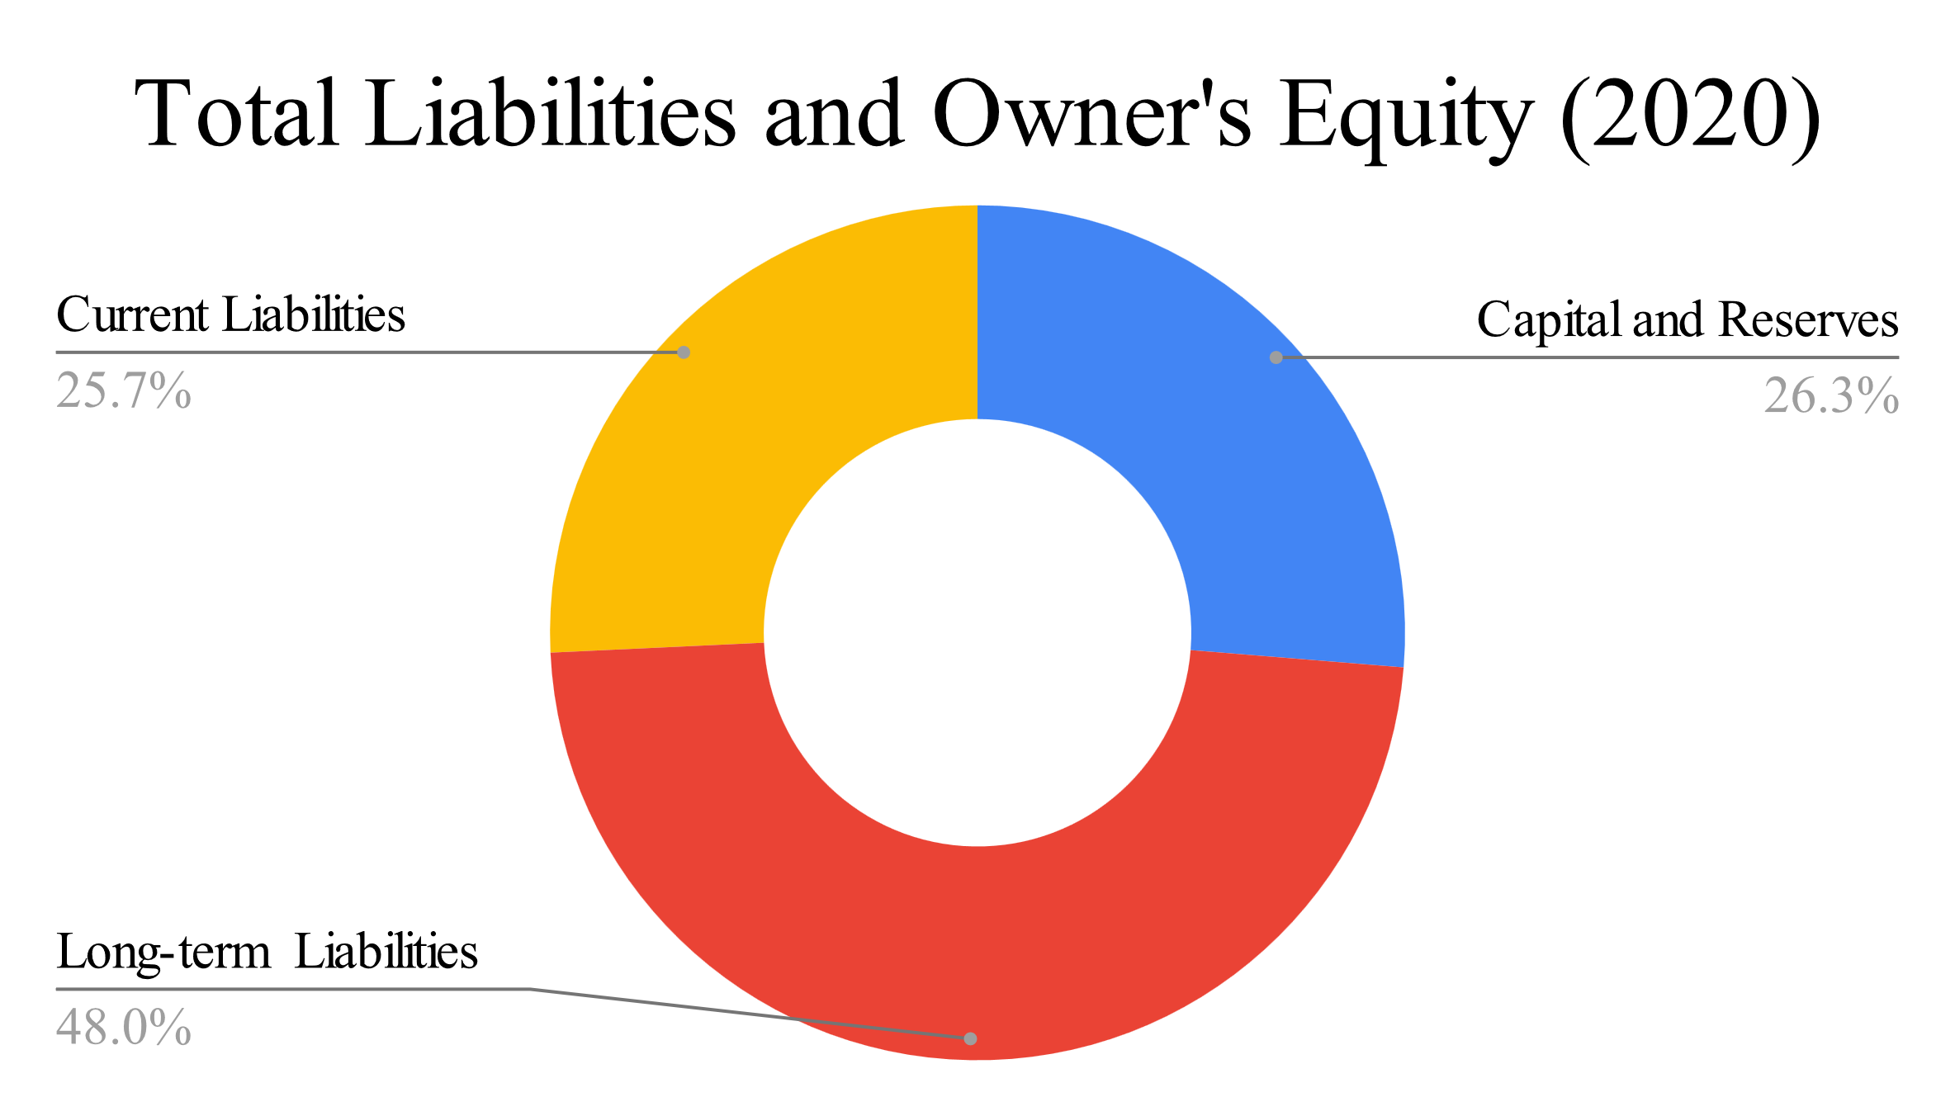
Vertical Analysis-DESCO (Balance Sheet)

Slide 9
Vertical Analysis (Balance Sheet)
INTER COMPANY
30 June, 2021
PARTICULARS | DESCO |  | TITAS
 | Amount | Percentage | Amount | Percentage
ASSETS
Non-current Assets | 52,202,477,849.00 | 65.96% | 53,195,628,122.00 | 29.47
Current Assets | 26,940,114,942.00 | 34.04% | 127,327,858,394.00 | 70.53%
Total Assets | 79,142,592,791.00 | 100.00% | 180,523,486,516.00 | 100%
EQUITY AND LIABILITIES
Capital and Reserves | 25,938,786,858.00 | 32.77% | 0.00 | 0%
Shareholders’ Equity | 0.00 | 0.00% | 71,783,221,940.00 | 39.76%
Long-term Liabilities | 35,182,962,340.00 | 44.46% | 0.00 | 0%
Non-Current Liabilities | 0.00 | 0.00% | 29,563,592,263.00 | 16.38%
Current Liabilities | 18,020,843,592.00 | 22.77% | 79,176,672,313.00 | 43.86%
Total Equity and Liabilities | 79,142,592,791.00 | 100.00% | 180,523,486,516.00 | 100.00%

Slide 10
Vertical Analysis (Balance Sheet)
TITAS
DESCO

Slide 11
Vertical Analysis (Balance Sheet)
TITAS
DESCO

Slide 12
Vertical Analysis (Income statement)
DESCO
Particulars | July 01, 2020 to June 30, 2021 |  | July 01, 2019 to June 30, 2020
 | Amount in Taka | Percentage | Amount in Taka | Percentage
Distribution Revenue | 4,603,084,565.00 | 10.59% | 4,323,577,620.00 | 10.97%
Energy Sales (Net of VAT) | 43,470,529,706.00 | 100.00% | 39,423,939,203.00 | 100.00%
Total Operating Revenue | 5,514,799,374.00 | 12.69% | 4,957,816,694.00 | 12.58%
Less: Cost of Energy Sales | 2,326,933,433.00 | 5.35% | 1,865,376,127.00 | 4.73%
Gross Profit | 3,187,865,940.00 | 7.33% | 3,092,440,567.00 | 7.84%
Less: Operating Expenses | 2,972,738,088.00 | 6.84% | 2,545,036,938.00 | 6.46%
Total Operating Profit / (Loss) | 1,742,788,205.00 | 4.01% | 1,972,263,568.00 | 5.00%
Profit or Loss | 739,135,174.00 | 1.70% | 455,646,848.00 | 1.16%
Gain on Revaluation of asset | 7,178,602,654.00 | 1.56 | 0.00 | 0.00
Total Other Comprehensive Income | 6,860,905,776.00 | 1.49 | 0.00 | 0.00
Total Profit or Loss and Other Comprehensive Income | 7,600,040,950.00 | 17.48% | 455,646,848.00 | 1.16%

Slide 13
Vertical Analysis (Income statement)
TITAS
Particulars | 2020-2021 |  | 2019-2020
 | Amount in taka | Percentage | Amount in taka | Percentage
Revenue | 178,662,338,030.00 | 100.00% | 169,879,389,331.00 | 100.00%
Gross Profit | 6,781,184,508.00 | 3.80% | 6,194,151,668.00 | 3.65%
Gross Operating Profit | 2,089,194,767.00 | 1.17% | 1,114,434,650.00 | 0.66%
Net Operating Profit | 2,047,542,761.00 | 1.15% | 1,072,444,936.00 | 0.63%
Total comprehensive income | 3,460,564,156.00 | 1.94% | 3,597,315,303.00 | 2.12%

Slide 14
Vertical Analysis (Income statement)
INTER COMPANY
30 June, 2021
PARTICULARS | DESCO |  | TITAS
 | Amount | Percentage | Amount | Percentage
Distribution Revenue | 4,603,084,565.00 | 10.59% | 178,662,338,030.00 | 100%
Energy Sales (Net of VAT) | 43,470,529,706.00 | 100.00% | 0 | 0%
Total Operating Revenue | 5,514,799,374.00 | 12.69% | 0 | 0%
Less: Cost of Sales | 2,326,933,433.00 | 5.35% | 171,881,153,522.00 | 96.20%
Gross Profit | 3,187,865,940.00 | 7.33% | 6,781,184,508.00 | 3.80%
Gross Operating Profit | 0.00 | 0.00% | 2,089,194,767.00 | 1.17%
Less: Operating Expenses | 2,972,738,088.00 | 6.84% | 0 | 0%
Total Operating Profit / (Loss) | 1,742,788,205.00 | 4.01% | 2,047,542,761.00 | 1.15%
Total Profit or Loss and Other Comprehensive Income | 7,600,040,950.00 | 17.48% | 3,460,564,156.00 | 1.94%

Slide 15
HORIZONTAL ANALYSIS

Slide 16
Horizontal Analysis (Balance Sheet)
DESCO
Account Titles | Amount in Taka |  | Increase/Decrease during 2021
 | June 30, 2021 | June 30, 2020 | Amount in Taka | Percentage
ASSETS
Non-current Assets | 52,202,477,849.00 | 40,585,729,350.00 | 11,616,748,499.00 | 28.62 %
Current Assets | 26,940,114,942.00 | 30,117,446,368.00 | (3,177,331,426.00) | (10.55)%
Total Assets | 79,142,592,791.00 | 70,703,175,717.00 | 8,439,417,074.00 | 11.94 %
EQUITY AND LIABILITIES
Capital and Reserves | 25,938,786,858.00 | 18,589,300,583.00 | 7,349,486,275.00 | 39.54 %
Long-term Liabilities | 35,182,962,340.00 | 33,913,532,799.00 | 1,269,429,541.00 | 3.74 %
Current Liabilities | 18,020,843,592.00 | 18,200,342,334.00 | (179,498,742.00) | (0.99)%
Total Equity and Liabilities | 79,142,592,791.00 | 70,703,175,717.00 | 8,439,417,074.00 | 11.94 %

Slide 17
Horizontal Analysis (Balance Sheet)
TITAS
Account Titles | Amount in Taka |  | Increase/Decrease during 2021
 | June 30, 2021 | June 30, 2020 | Amount in Taka | Percentage
ASSETS
Non-current Assets | 53,195,628,122.00 | 58,738,552,101.00 | (5,542,923,979.00) | (9.44)%
Current Assets | 127,327,858,394.00 | 121,857,457,009.00 | 5,470,401,385.00 | 4.49 %
Total Assets | 180,523,486,516.00 | 180,596,009,109.00 | (72,522,593.00) | (0.04)%
EQUITY AND LIABILITIES
Shareholders’ Equity | 71,783,221,940.00 | 70,621,664,474.00 | 1,161,557,466.00 | 1.64 %
Non-Current Liabilities | 29,563,592,263.00 | 27,105,613,285.00 | 2,457,978,978.00 | 9.07 %
Current Liabilities | 79,176,672,313.00 | 82,868,731,349.00 | (3,692,059,036.00) | (4.46)%
Total Equity and Liabilities | 180,523,486,516.00 | 180,596,009,109.00 | (72,522,593.00) | (0.04)%

Slide 18
horizontal Analysis (Balance Sheet)
INTER COMPANY
Account Titles | DESCO |  | TITAS
 | Increase/Decrease during 2021 |  | Increase/Decrease during 2021
 | Amount in Taka | Percentage | Amount in Taka | Percentage
ASSETS
Non-current Assets | 11,616,748,499.00 | 28.62 % | (5,542,923,979.00) | (9.44)%
Current Assets | (3,177,331,426.00) | (10.55)% | 5,470,401,385.00 | 4.49 %
Total Assets | 8,439,417,074.00 | 11.94 % | (72,522,593.00) | (0.04)%
EQUITY AND LIABILITIES
Shareholders’ Equity/Capital and Reserves | 7,349,486,275.00 | 39.54 % | 1,161,557,466.00 | 1.64 %
Non-Current Liabilities/Long-term Liabilities | 1,269,429,541.00 | 3.74 % | 2,457,978,978.00 | 9.07 %
Current Liabilities | (179,498,742.00) | (0.99)% | (3,692,059,036.00) | (4.46)%
Total Equity and Liabilities | 8,439,417,074.00 | 11.94 % | (72,522,593.00) | (0.04)%

Slide 19
Horizontal Analysis (Income statement)
DESCO
Particulars | July 01, 2020 to June 30, 2021 | July 01, 2019 to June 30, 2020 | Increase/Decrease during 2021
 | Amount in Taka | Amount in Taka | Amount in Taka | Percentage
Distribution Revenue | 4,603,084,565.00 | 4,323,577,620.00 | 279,506,945.00 | 6.46 %
Energy Sales (Net of VAT) | 43,470,529,706.00 | 39,423,939,203.00 | 4,046,590,503.00 | 10.26 %
Total Operating Revenue | 5,514,799,374.00 | 4,957,816,694.00 | 556,982,680.00 | 11.23 %
Less: Cost of Energy Sales | 2,326,933,433.00 | 1,865,376,127.00 | 461,557,306.00 | 24.74 %
Gross Profit | 3,187,865,940.00 | 3,092,440,567.00 | 95,425,373.00 | 3.09 %
Less: Operating Expenses | 2,972,738,088.00 | 2,545,036,938.00 | 427,701,150.00 | 16.81 %
Total Operating Profit / (Loss) | 1,742,788,205.00 | 1,972,263,568.00 | (229,475,363.00) | (11.64)%
Profit or Loss | 739,135,174.00 | 455,646,848.00 | 283,488,326.00 | 62.22 %
Gain on Revaluation of asset | 7,178,602,654.00 | - | 7,178,602,654.00 | -
Less: deferred tax on Revaluation gain | (317,696,879.00) | - | (317,696,879.00) | -
Total Profit or Loss and Other Comprehensive Income | 7,600,040,950.00 | 455,646,848.00 | 7,144,394,102.00 | 1,567.97 %

Slide 20
horizontal Analysis (Income statement)
TITAS
Particulars | 2020-2021 | 2019-2020 | Increase/Decrease during 2021
 | Amount in taka | Amount in taka | Amount in Taka | Percentage
Revenue | 178,662,338,030.00 | 169,879,389,331.00 | 8,782,948,699.00 | 5.17 %
Gross Profit | 6,781,184,508.00 | 6,194,151,668.00 | 587,032,840.00 | 9.48 %
Gross Operating Profit | 2,089,194,767.00 | 1,114,434,650.00 | 974,760,117.00 | 87.47 %
Net Operating Profit | 2,047,542,761.00 | 1,072,444,936.00 | 975,097,825.00 | 90.92 %
Other comprehensive income | 810,550.00 | (748,200.00) | 1,558,750.00 | (208.33)%
Total comprehensive income | 3,460,564,156.00 | 3,597,315,303.00 | (136,751,147.00) | (3.80)%

Slide 21
Horizontal Analysis (Income statement)
INTER COMPANY
Particulars | DESCO |  | TITAS
 | Increase/Decrease during 2021 |  | Increase/Decrease during 2021
 | Amount in Taka | Percentage | Amount in Taka | Percentage
Distribution Revenue | 279,506,945.00 | 6.46 % | 8,782,948,699.00 | 5.17 %
Energy Sales (Net of VAT) | 4,046,590,503.00 | 10.26 % | - | -
Total Operating Revenue | 556,982,680.00 | 11.23 % | 8,782,948,699.00 | 5.17 %
Less: Cost of Sales | 461,557,306.00 | 24.74 % | 8,195,915,859.00 | 5.01 %
Gross Profit | 95,425,373.00 | 3.09 % | 587,032,840.00 | 9.48 %
Gross Operating Profit | (229,475,363.00) | (11.64)% | 974,760,117.00 | 87.47 %
Less: Operating Expenses | 427,701,150.00 | 16.81 % | (375,928,179.00) | (7.24)%
Total Operating Profit / (Loss) | (229,475,363.00) | (11.64)% | 975,097,825.00 | 90.92 %
Add: Non-operating Income/(Expense) | 62,296,074.00 | (5.80)% | (1,727,305,146.00) | (40.75)%
Total Other Comprehensive Income | 6,860,905,776.00 | - | 1,558,750.00 | (208.33)%
Total Profit or Loss and Other Comprehensive Income | 7,144,394,102.00 | 1,567.97 % | (136,751,147.00) | (3.80)%

Slide 22
RATIO ANALYSIS

Slide 23
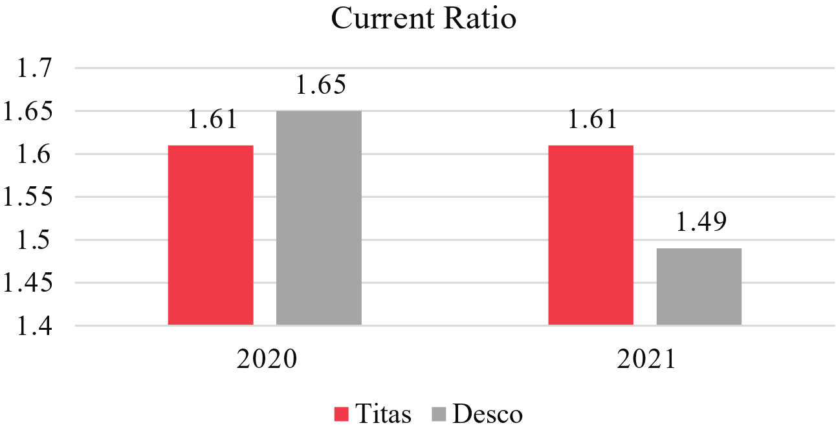
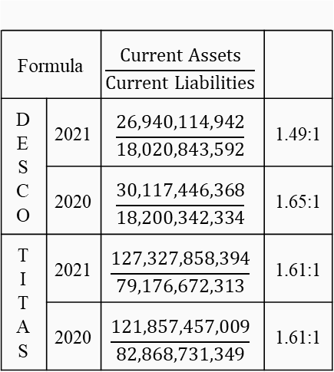
CURRENT RATIO
Formula |  | $$\frac{Current Assets}{Current Liabilities}$$
DESCO | 2021 | $$\frac{26,940,114,942}{18,020,843,592}$$ | 1.49:1
 | 2020 | $$\frac{30,117,446,368}{18,200,342,334}$$ | 1.65:1
TITAS | 2021 | $$\frac{127,327,858,394}{79,176,672,313}$$ | 1.61:1
 | 2020 | $$\frac{121,857,457,009}{82,868,731,349}$$ | 1.61:1

Slide 24
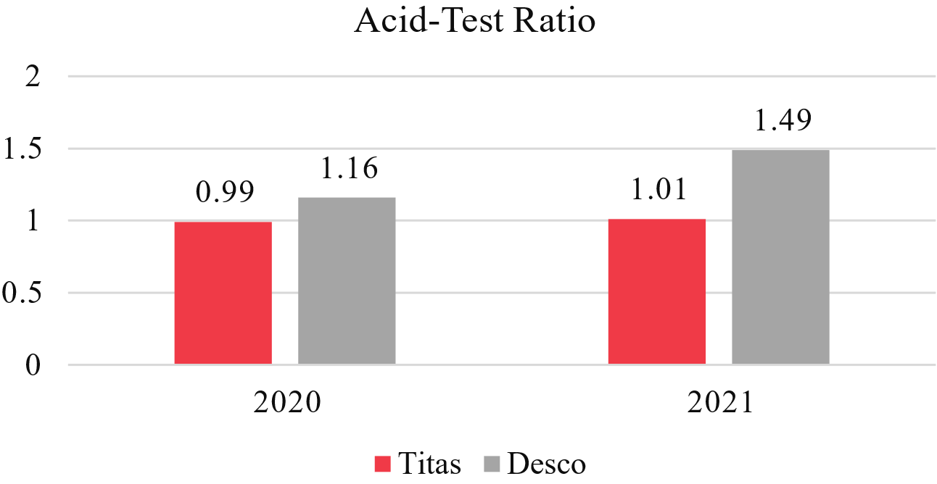
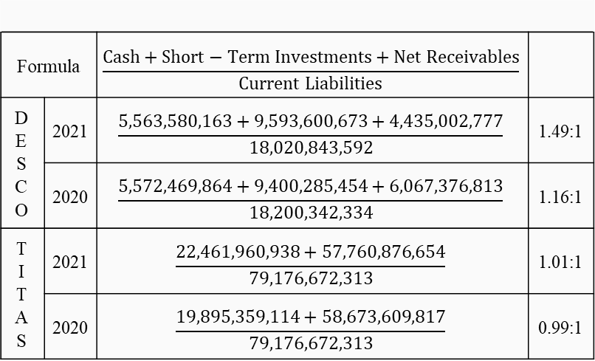
acid-test RATIO
Formula |  | $$\frac{Cash+Short−Term Investments+Net Receivables}{Current Liabilities}$$
DESCO | 2021 | $$\frac{5,563,580,163+9,593,600,673+4,435,002,777}{18,020,843,592}$$ | 1.49:1
 | 2020 | $$\frac{5,572,469,864+9,400,285,454+6,067,376,813}{18,200,342,334}$$ | 1.16:1
TITAS | 2021 | $$\frac{22,461,960,938+57,760,876,654}{79,176,672,313}$$ | 1.01:1
 | 2020 | $$\frac{19,895,359,114+58,673,609,817}{79,176,672,313}$$ | 0.99:1

Slide 25
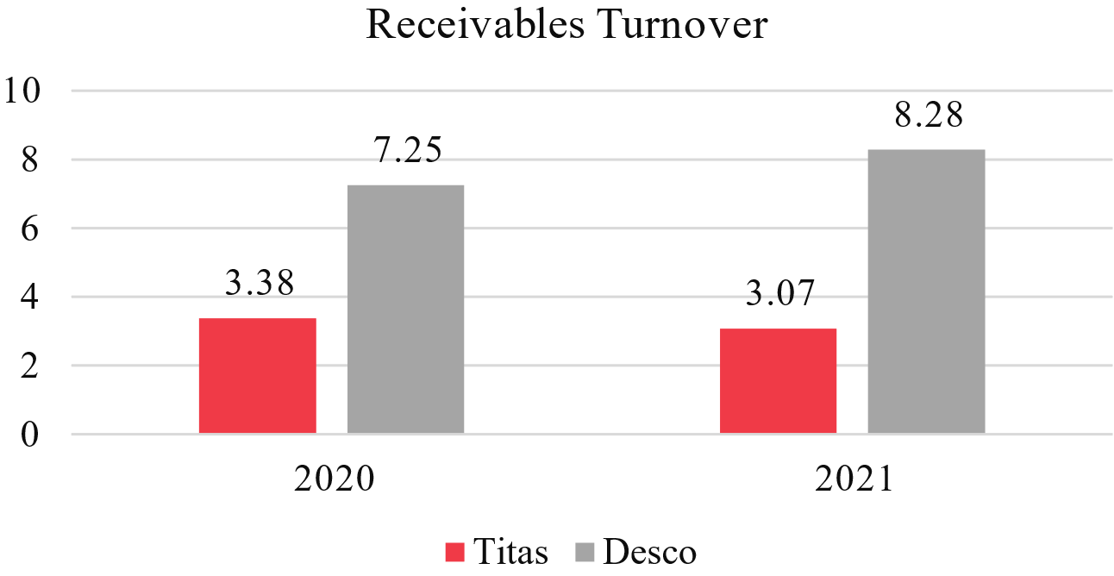
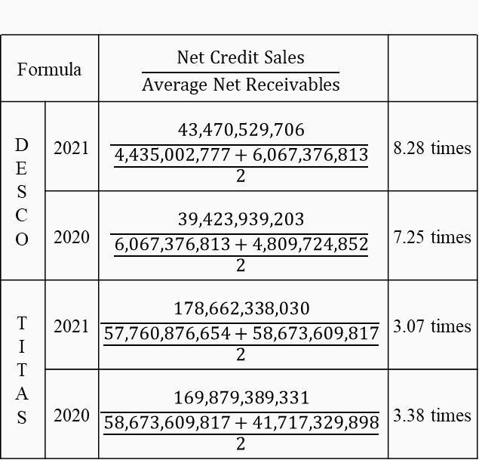
Receivables turnover
Formula |  | $$\frac{Net Credit Sales}{Average Net Receivables}$$
DESCO | 2021 | $$\frac{43,470,529,706}{\frac{4,435,002,777+6,067,376,813}{2}}$$ | 8.28 times
 | 2020 | $$\frac{39,423,939,203}{\frac{6,067,376,813+4,809,724,852}{2}}$$ | 7.25 times
TITAS | 2021 | $$\frac{178,662,338,030}{\frac{57,760,876,654+58,673,609,817}{2}}$$ | 3.07 times
 | 2020 | $$\frac{169,879,389,331}{\frac{58,673,609,817+41,717,329,898}{2}}$$ | 3.38 times

Slide 26
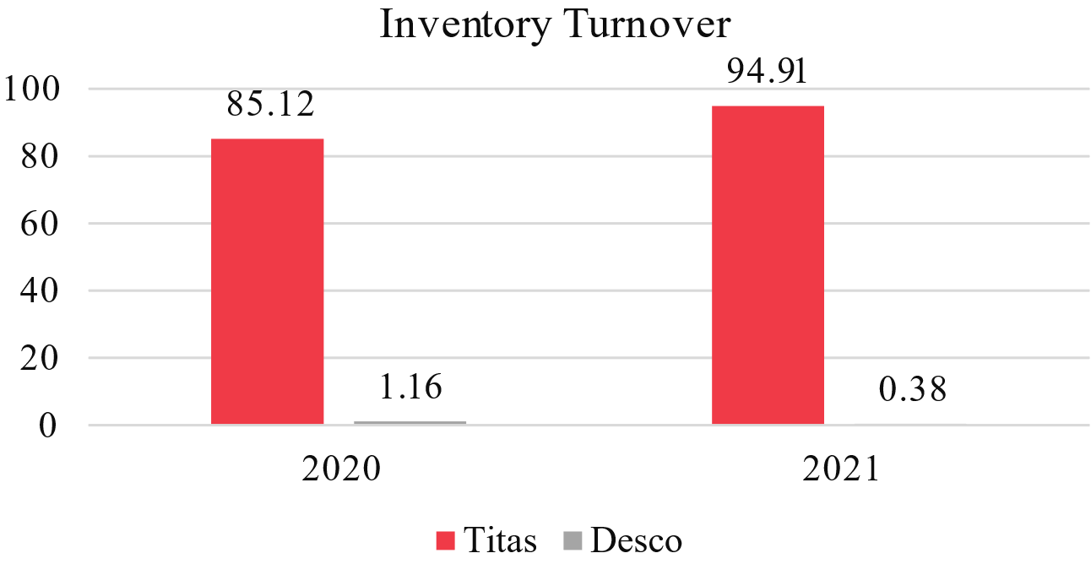
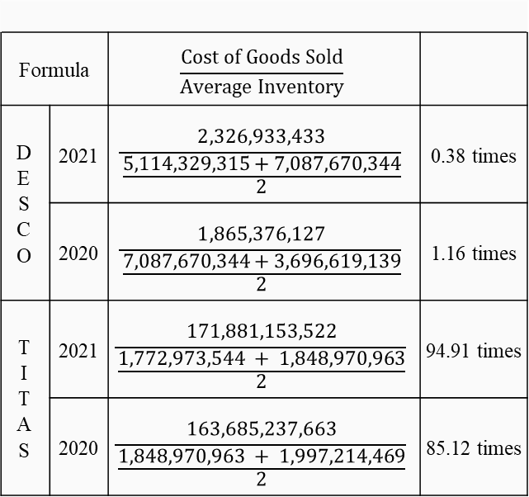
Inventory turnover
Formula |  | $$\frac{Cost of Goods Sold}{Average Inventory}$$
DESCO | 2021 | $$\frac{2,326,933,433}{\frac{5,114,329,315+7,087,670,344}{2}}$$ | 0.38 times
 | 2020 | $$\frac{1,865,376,127}{\frac{7,087,670,344+3,696,619,139}{2}}$$ | 1.16 times
TITAS | 2021 | $$\frac{171,881,153,522}{\frac{1,772,973,544 + 1,848,970,963}{2}}$$ | 94.91 times
 | 2020 | $$\frac{163,685,237,663}{\frac{1,848,970,963 + 1,997,214,469}{2}}$$ | 85.12 times

Slide 27
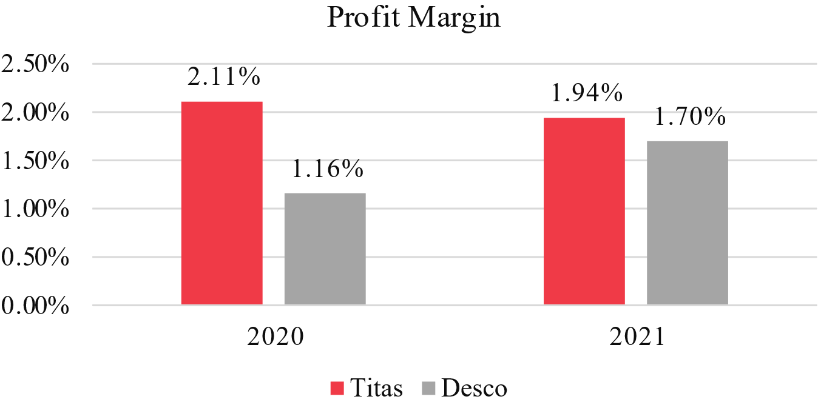
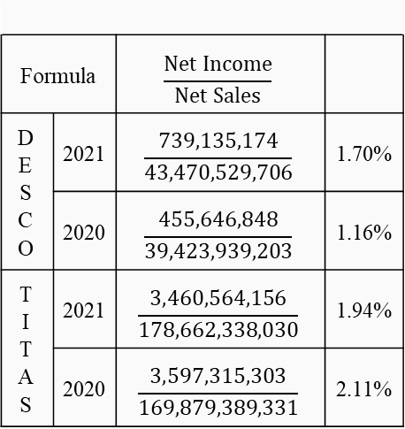
Profit margin
Formula |  | $$\frac{Net Income}{Net Sales}$$
DESCO | 2021 | $$\frac{739,135,174}{43,470,529,706}$$ | 1.70%
 | 2020 | $$\frac{455,646,848}{39,423,939,203}$$ | 1.16%
TITAS | 2021 | $$\frac{3,460,564,156}{178,662,338,030}$$ | 1.94%
 | 2020 | $$\frac{3,597,315,303}{169,879,389,331}$$ | 2.11%

Slide 28
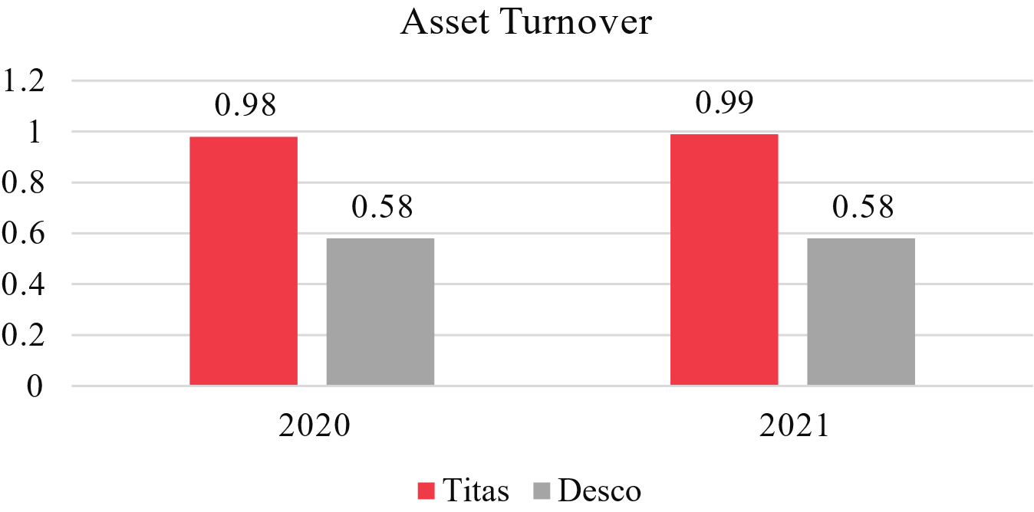
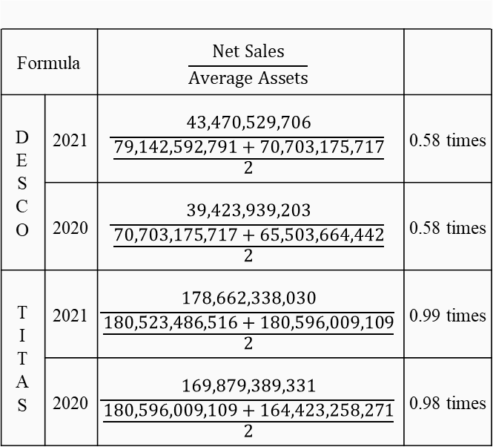
Asset turnover
Formula |  | $$\frac{Net Sales}{Average Assets}$$
DESCO | 2021 | $$\frac{43,470,529,706}{\frac{79,142,592,791+70,703,175,717}{2}}$$ | 0.58 times
 | 2020 | $$\frac{39,423,939,203}{\frac{70,703,175,717+65,503,664,442}{2}}$$ | 0.58 times
TITAS | 2021 | $$\frac{178,662,338,030}{\frac{180,523,486,516+180,596,009,109}{2}}$$ | 0.99 times
 | 2020 | $$\frac{169,879,389,331}{\frac{180,596,009,109+164,423,258,271}{2}}$$ | 0.98 times

Slide 29
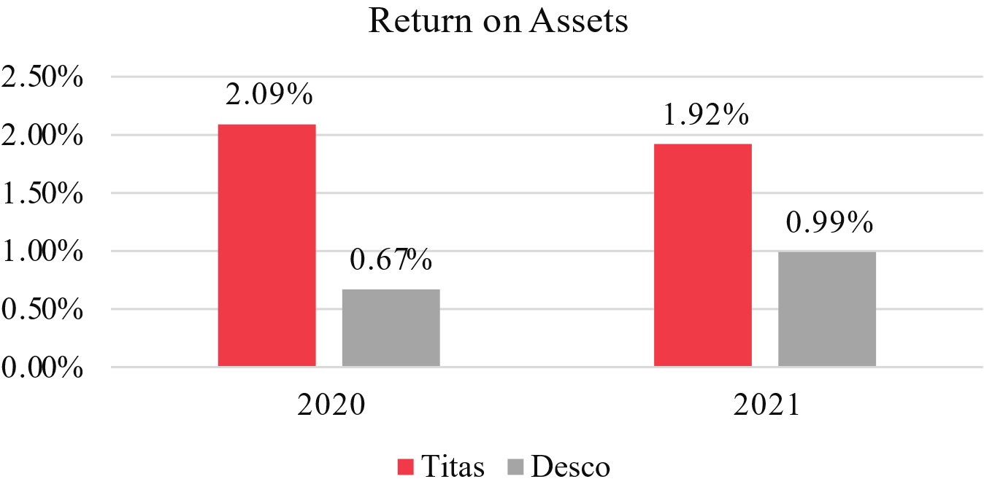
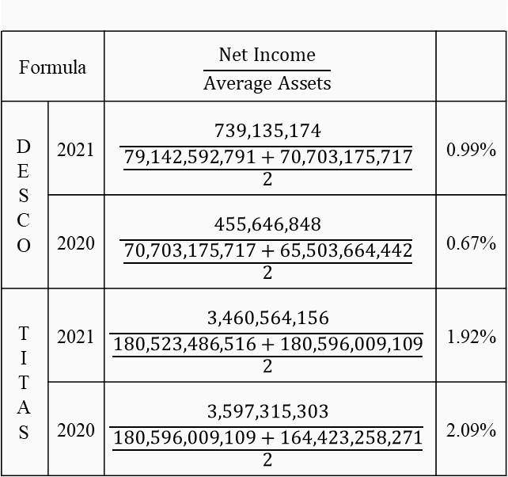
Return on assets
Formula |  | $$\frac{Net Income}{Average Assets}$$
DESCO | 2021 | $$\frac{739,135,174}{\frac{79,142,592,791+70,703,175,717}{2}}$$ | 0.99%
 | 2020 | $$\frac{455,646,848}{\frac{70,703,175,717+65,503,664,442}{2}}$$ | 0.67%
TITAS | 2021 | $$\frac{3,460,564,156}{\frac{180,523,486,516+180,596,009,109}{2}}$$ | 1.92%
 | 2020 | $$\frac{3,597,315,303}{\frac{180,596,009,109+164,423,258,271}{2}}$$ | 2.09%

Slide 30
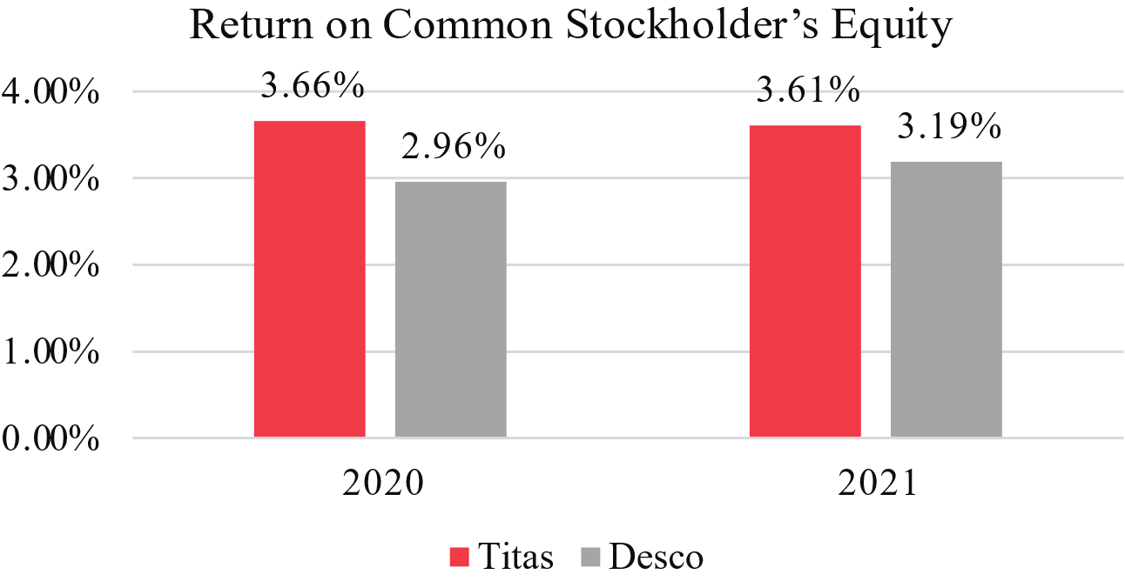
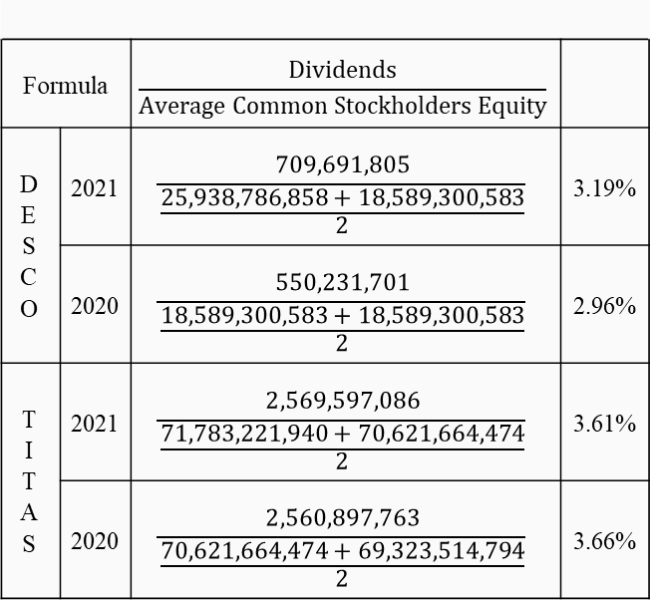
Return on common stockholders equity
Formula |  | $$\frac{Dividends}{Average Common Stockholders Equity}$$
DESCO | 2021 | $$\frac{709,691,805}{\frac{25,938,786,858+18,589,300,583}{2}}$$ | 3.19%
 | 2020 | $$\frac{550,231,701}{\frac{18,589,300,583+18,589,300,583}{2}}$$ | 2.96%
TITAS | 2021 | $$\frac{2,569,597,086}{\frac{71,783,221,940+70,621,664,474}{2}}$$ | 3.61%
 | 2020 | $$\frac{2,560,897,763}{\frac{70,621,664,474+69,323,514,794}{2}}$$ | 3.66%

Slide 31
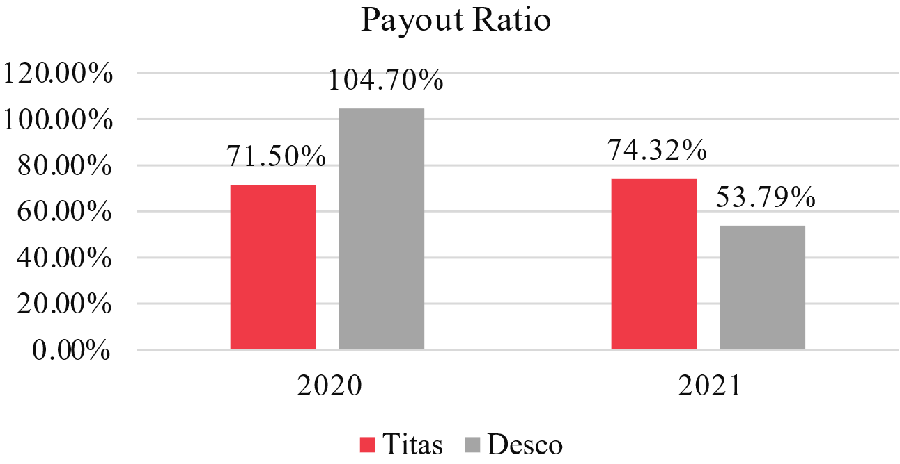
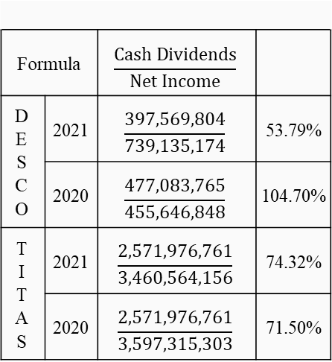
payout RATIO
Formula |  | $$\frac{Cash Dividends}{Net Income}$$
DESCO | 2021 | $$\frac{397,569,804}{739,135,174}$$ | 53.79%
 | 2020 | $$\frac{477,083,765}{455,646,848}$$ | 104.70%
TITAS | 2021 | $$\frac{2,571,976,761}{3,460,564,156}$$ | 74.32%
 | 2020 | $$\frac{2,571,976,761}{3,597,315,303}$$ | 71.50%

Slide 32
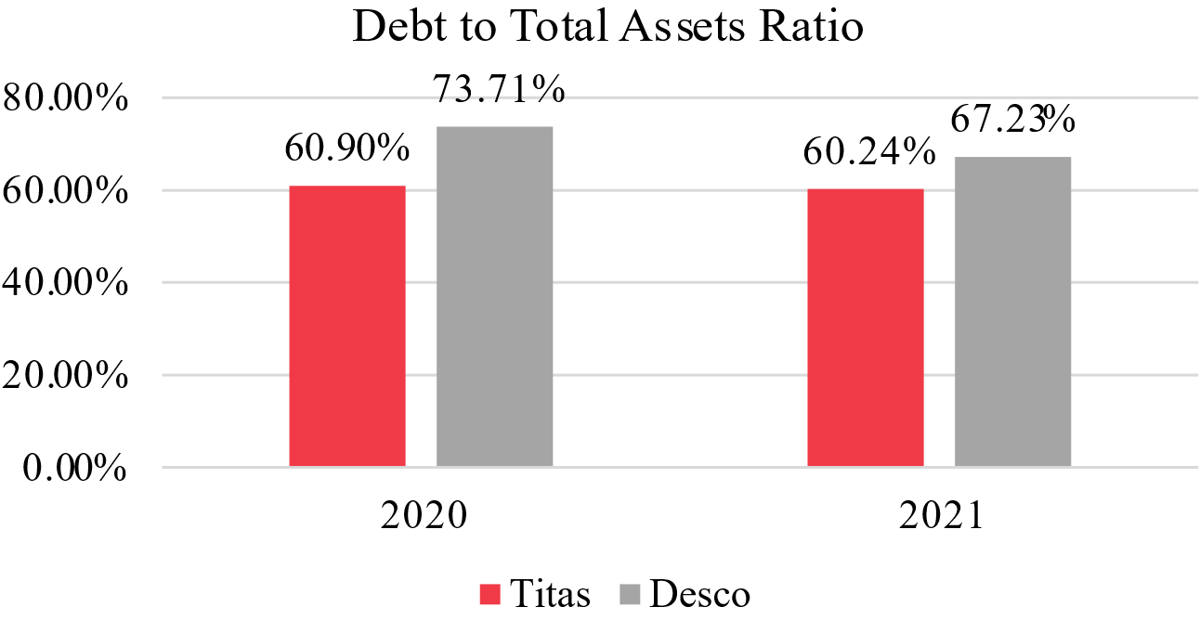
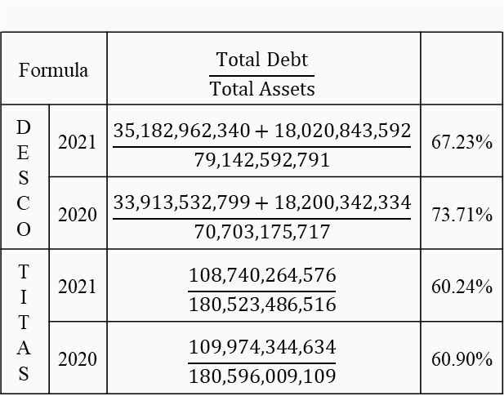
Debt to total assets RATIO
Formula |  | $$\frac{Total Debt}{Total Assets}$$
DESCO | 2021 | $$\frac{35,182,962,340+18,020,843,592}{79,142,592,791}$$ | 67.23%
 | 2020 | $$\frac{33,913,532,799+18,200,342,334}{70,703,175,717}$$ | 73.71%
TITAS | 2021 | $$\frac{108,740,264,576}{180,523,486,516}$$ | 60.24%
 | 2020 | $$\frac{109,974,344,634}{180,596,009,109}$$ | 60.90%

Slide 33
THANK YOU!

